Slide 1
CSC 490 Senior Capstone Presentation 1:
“MyAlmanack”
By: Justin Oakley, Hao Zhang, Mark Bures, Mike Resnik, and Pooya Motee
Disclaimer: All content are subject to change.
Notes:
Speaker Notes

Slide 2
Project Definition
The Problem: Managing schedules is difficult for college students and keeping up with a friend’s/group member’s schedule is just as difficult.
The Solution: A social media website with a shared-calendar.
The How: A private user-maintained calendar that can be shared with a select group of individuals.
Notes:
Justin

Slide 3
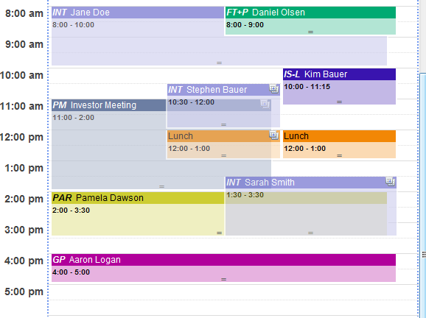
Project Requirements
Functional:
Social Network capability, profile and invite system with overlapping.
Usability:
Drag and drop calendar visual with ability to edit.
Notes:
Pooya

Slide 4
Project Requirements
System:
Python web-app made in MySQL and Django.
Security:
Only users can edit their own information.
Privacy settings can limit what information you share with others.
Notes:
Mike

Slide 5
Project Specification
Domain
This application is aimed at formal, casual groups and / or individuals willing to share schedules with peers for collaborative event planning.
Platform
This application will work on any device with an Internet connection, a modern web browser, and a decent screen resolution (i.e. smartwatches will not work).
Genre
This is a productivity application with a minor social media focus.
Notes:
Mark

Slide 6

Project Specification
Development
Front-end
User interface: Bootstrap 4, wireframe.cc
Scripting: jQuery
Back-end
Web server: Python 3, Django 2.1, django-bootstrap4, mysqlclient, see all other dependencies here
Database server: MySQL 5.7
Development Environment
Version control: Git + GitHub
Web and database server hosting: PythonAnywhere
Notes:
Hao

